Slide 1
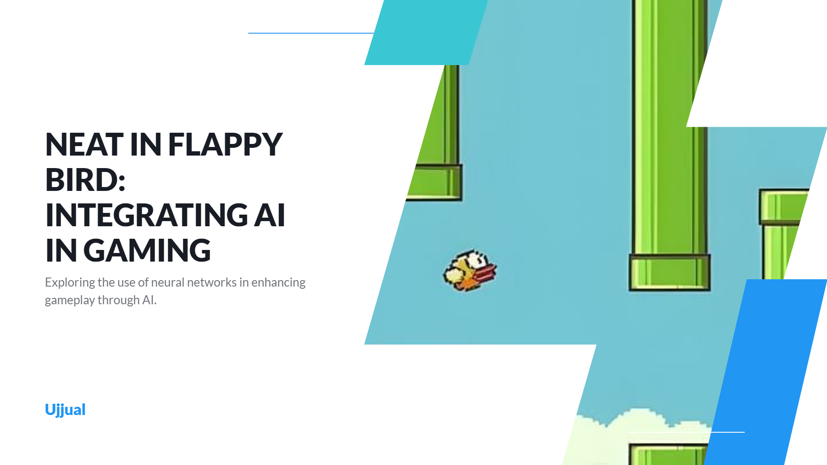
NEAT INFLAPPY BIRD: INTEGRATING AI IN GAMING
Exploring the use of neural networks in enhancing gameplay through AI.
Ujjual U Chunkath
Yashas Singh Chauhan
Ujjual

Slide 2
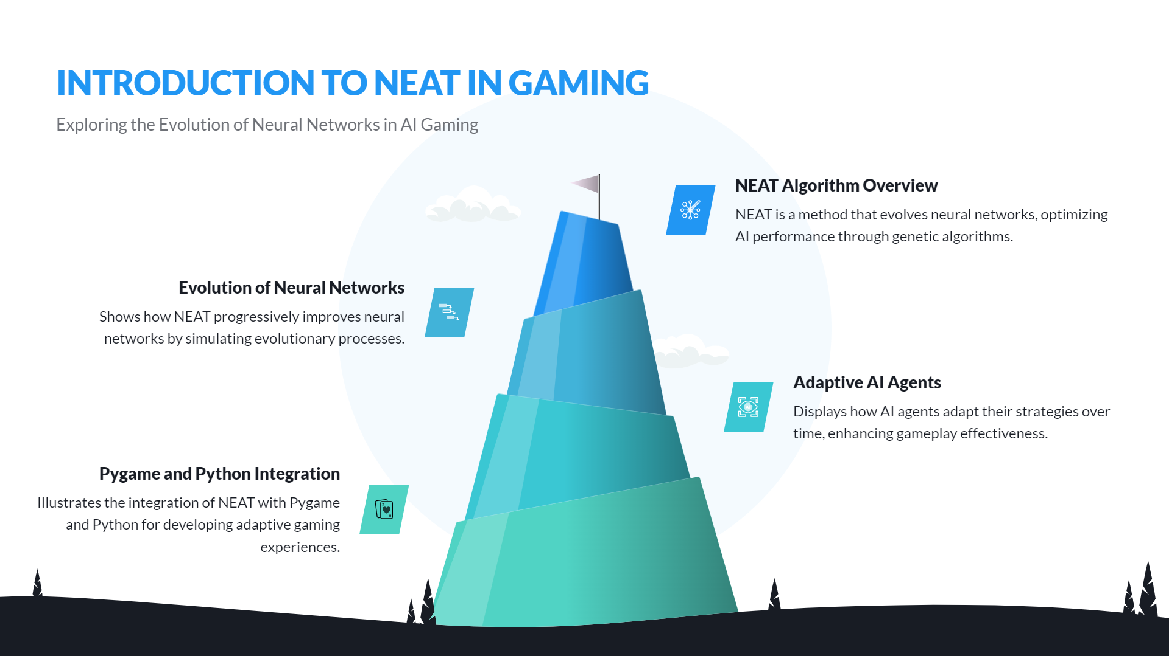

INTRODUCTION TO NEAT INGAMING
Exploring the Evolution of Neural Networks in Al Gaming
NEATAlgorithm Overview
NEAT is a method that evolves neural networks, optimizing AI performance through genetic algorithms.
Evolution of Neural Networks Shows how NEAT progressively improves neural networks by simulating evolutionary processes.
Adaptive AI Agents
Displays how AI agents adapt their strategies over time, enhancing gameplay effectiveness.
Pygame and Python Integration
Illustrates the integration of NEAT with Pygame and Python for developing adaptive gaming

Slide 3
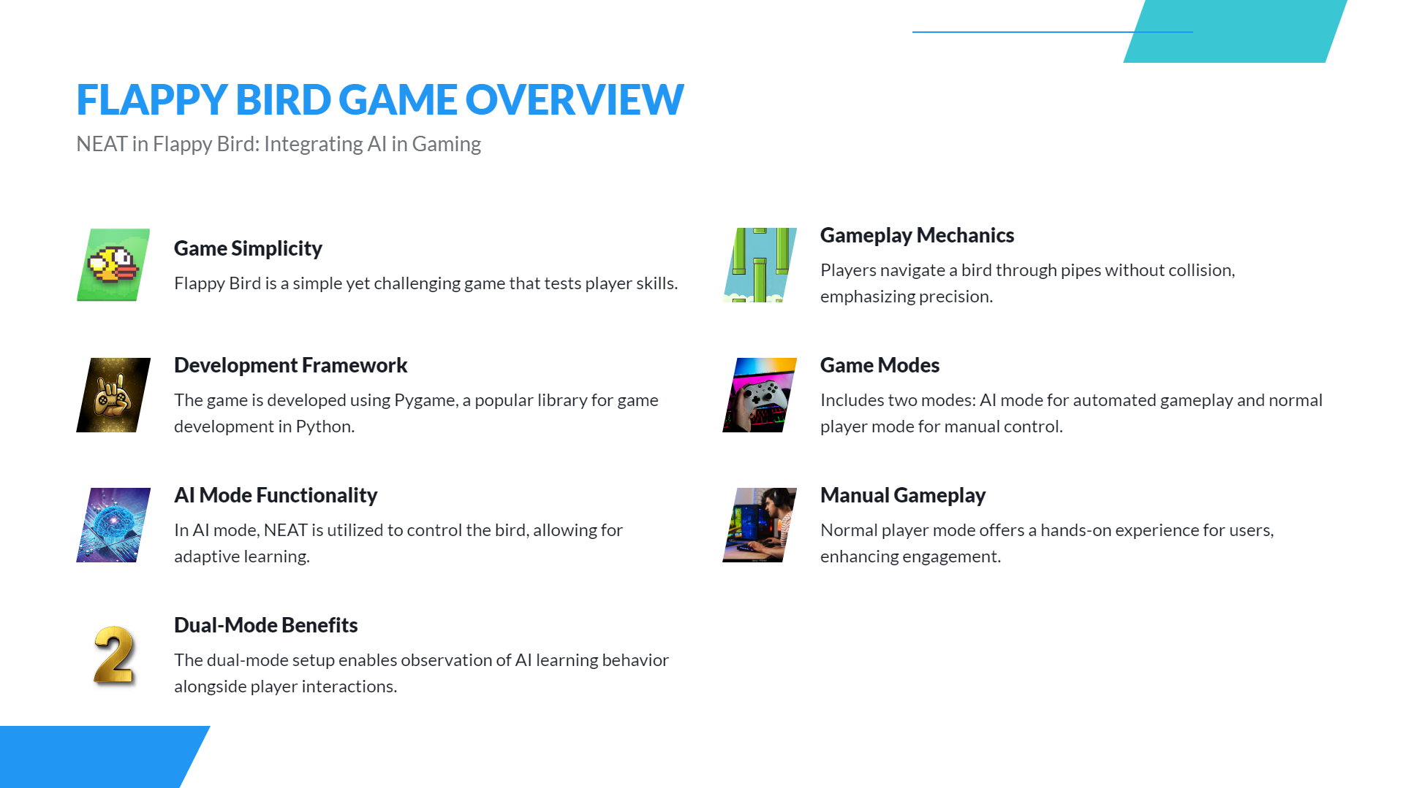
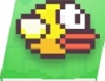


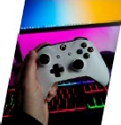
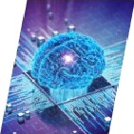



FLAPPY BIRD GAME OVERVIEW
NEAT in Flappy Bird: Integrating AI in Gaming
Game Simplicity
Flappy Bird is a simple yet challenging game that tests player skills.
Development Framework
The game is developed using Pygame, a popular library for game development in Python.
AI Mode Functionality
In AI mode, NEAT is utilized to control the bird, allowing for adaptive learning.
Dual-Mode Benefits
The dual-mode setup enables observation of AI learning behavior alongside player interactions.
Gameplay Mechanics
Players navigate a bird through pipes without collision, emphasizing precision.
Game Modes
Includes two modes: AI mode for automated gameplay and normal player mode for manual control.
Manual Gameplay
Normal player mode offers a hands-on experience for users, enhancing engagement.
^œn'ea 1°nç preseutotions

Slide 4
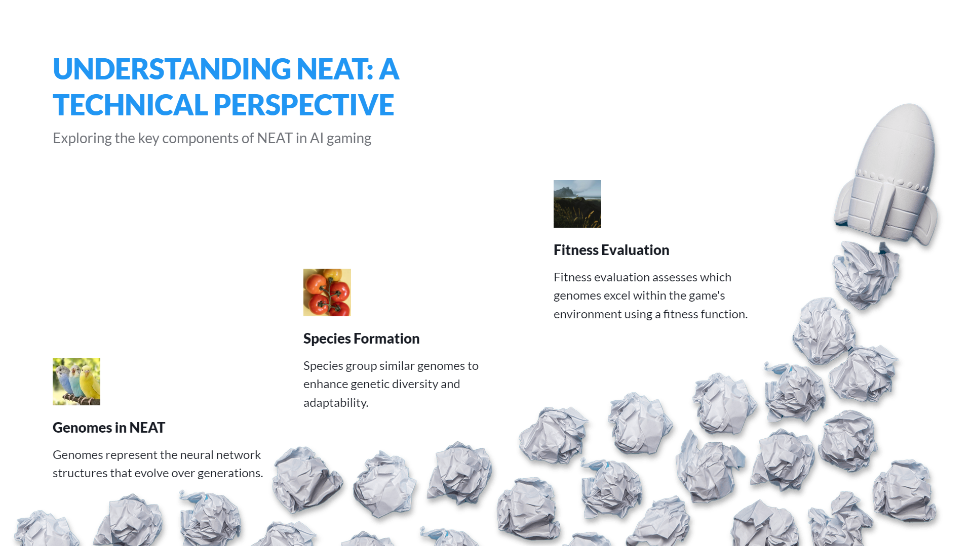

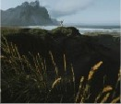


UNDERSTANDING NEAT: A
TECHNICAL PERSPECTIVE
Exploring the key components of NEAT in Al gaming
Fitness Evaluation
Fitness evaluation assesses which genomes excel within the game's environment using a fitness function

Slide 5
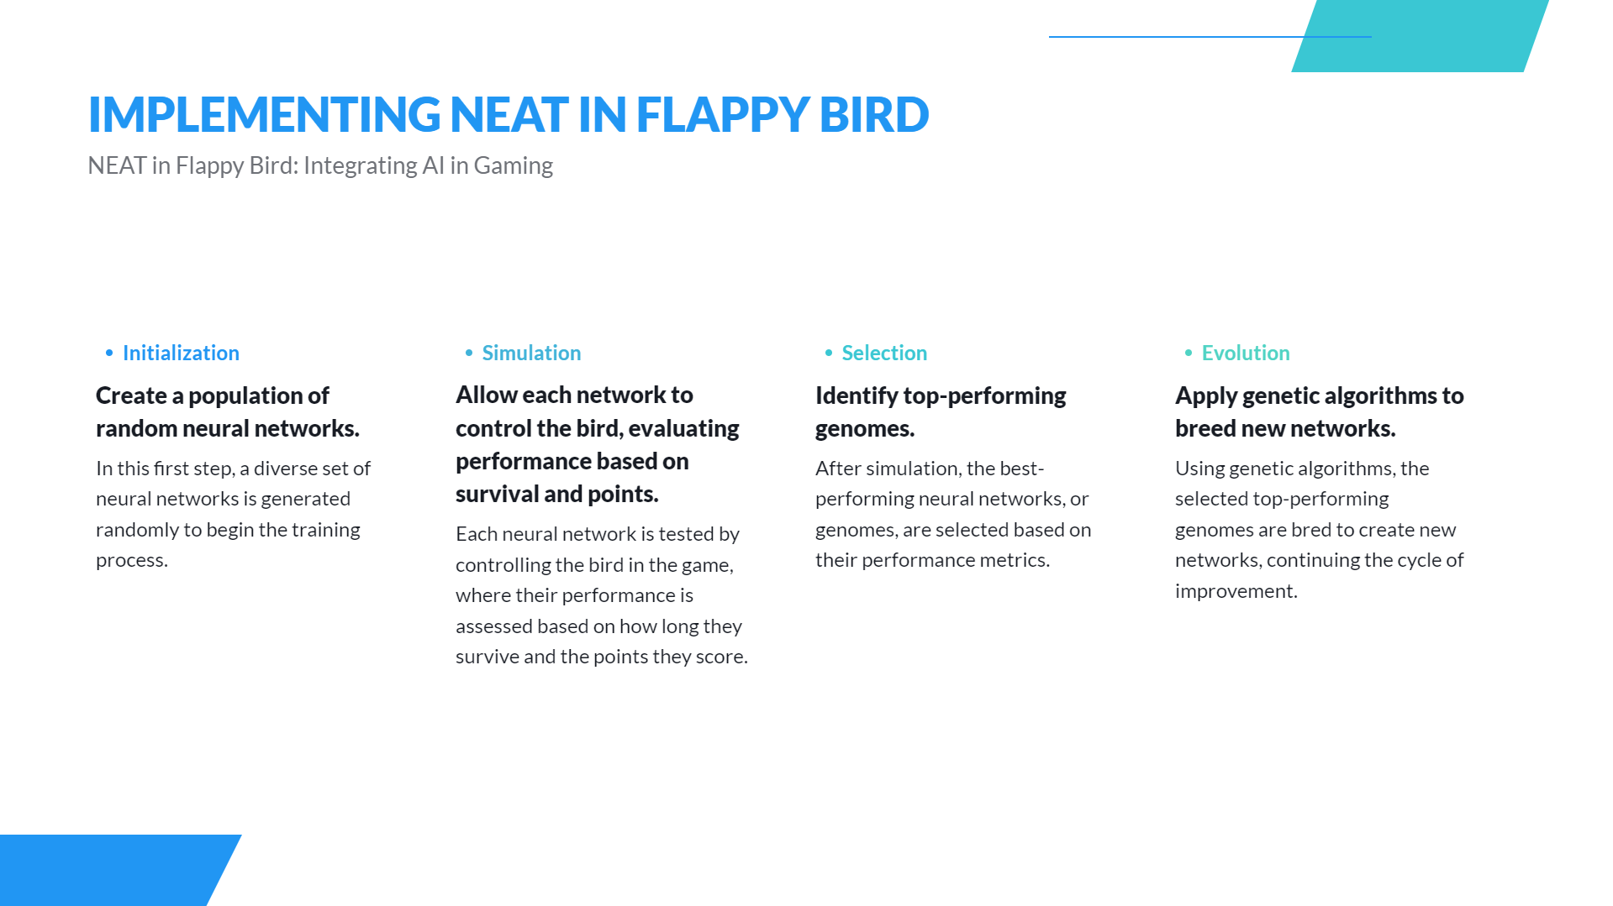
IMPLEMENTING NEAT IN FLAPPY BIRD
NEAT in Flappy Bird: Integrating AI in Gaming
Initialization
Create a population of random neural networks.
In this first step, a diverse set of neural networks is generated randomly to begin the training process.
Allow each network to control the bird, evaluating performance based on survival and points.
Each neural network is tested by controlling the bird in the game, where their performance is assessed based on how long they survive and the points they score.
Identifytop-performing genomes.
After simulation, the best- performing neural networks, or genomes, are selected based on their performance metrics.
Apply genetic algorithms to breed new networks.
Using genetic algorithms, the selected top-performing genomes are bred to create new networks, continuing the cycle of improvement.
^œn'ea 1°nç preseutotions

Slide 6
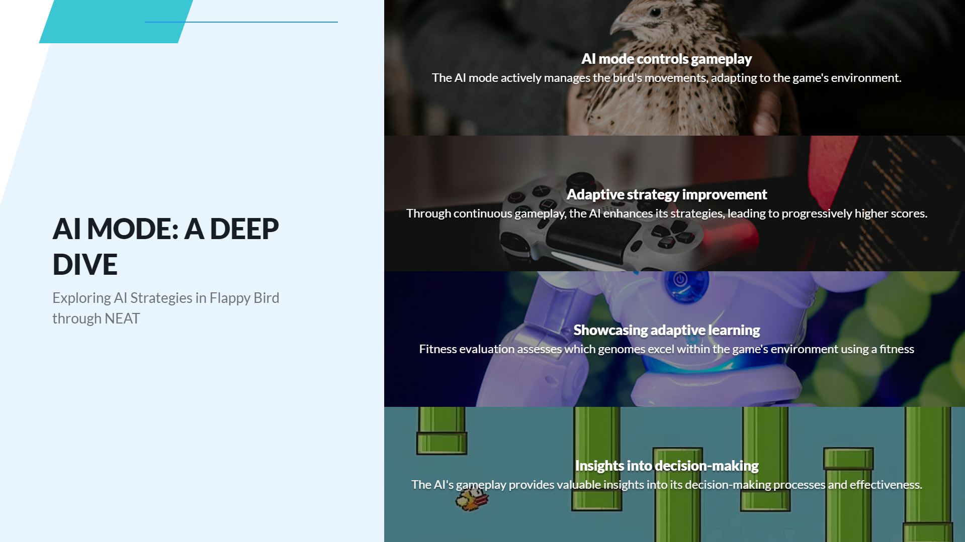
AI modecontrolsgameplay
The AI mode actively manages the bird's movements, adapting to the game's environment.
Adaptive strategy improvement
Through continuous gameplay, the AI enhances its strategies, leading to progressively higher scores.
AI MODE: A DEEP DIVE
Exploring Al Strategies in Flappy Bird through NEAT
“
Showcasingadaptive earning
which genomes excel within e game's environment using a fitness
Fitness evaluationsak
Insights into decision-making
The AI's ga play provides valuable insights into its decision-making processes and effectiveness.
—— c eoted usins presentations is

Slide 7
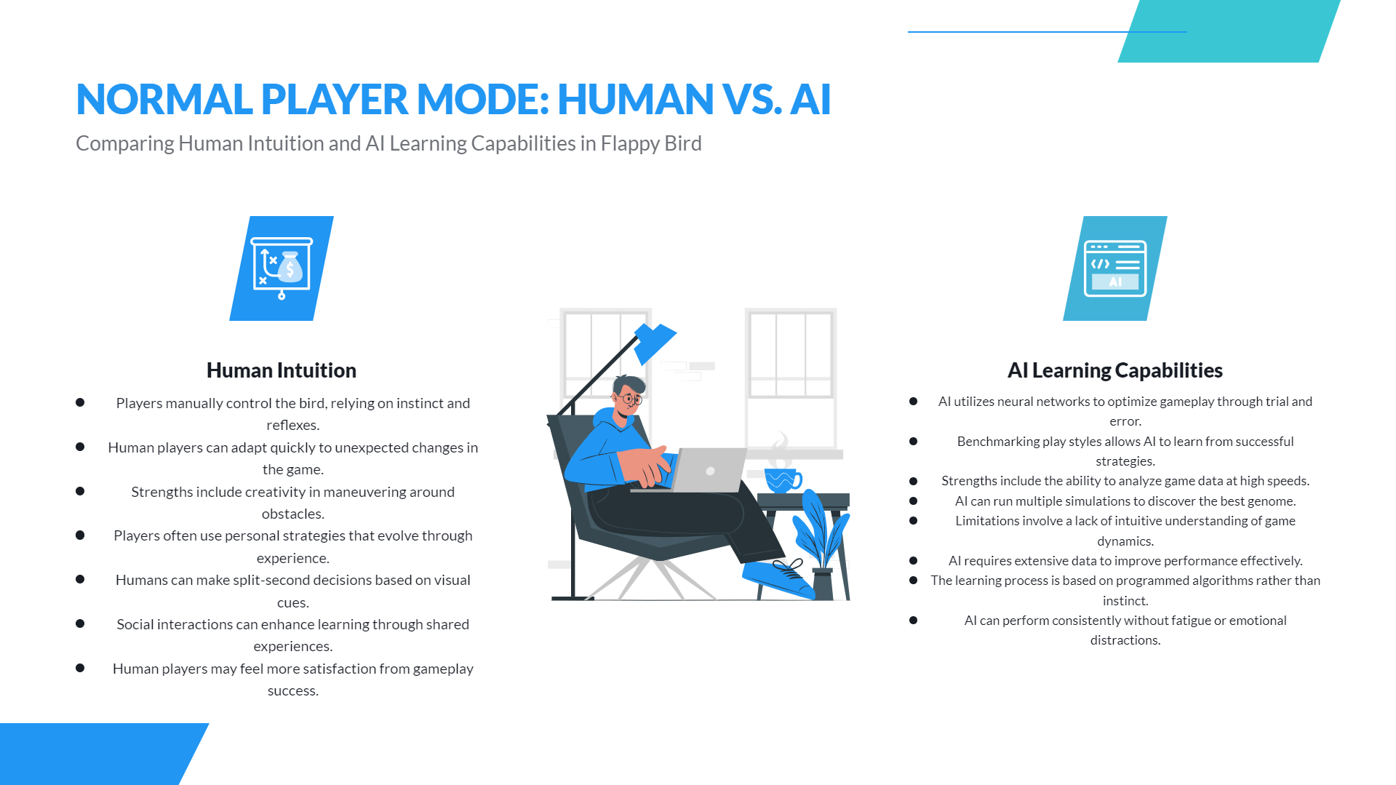




NORMAL PLAYERMODE: HUMANVS.AI
Comparing Human Intuition and AI Learning Capabilities in Flappy Bird
Human Intuition
Players manually control the bird, relying on instinct and
reflexes.
Human players can adapt quickly to unexpected changes in
the game.
Strengths include creativity in maneuvering around obstacles.
Players often use personal strategies that evolve through
experience.
Humans can make split-second decisions based on visual cues.
Social interactions can enhance learning through shared
experiences.
Human players may feel more satisfaction from gameplay success.
AI Learning Capabilities
AI utilizes neural networks to optimize gameplay through trial and
0
Benchmarking play styles allows AI to learn from successful
¥
0
Strengths include the ability to analyze game data at high speeds. AI can run multiple simulations to discover the best genome. Limitations involve a lack of intuitive understanding of game dynam ics.
¥ Al requires extensive data to improve performance effectively.
€ The learning process is based on programmed algorit hms rather than
instinct.
Al can perform consistently without fatigue or emotional
distractions.
•
•
0

Slide 8
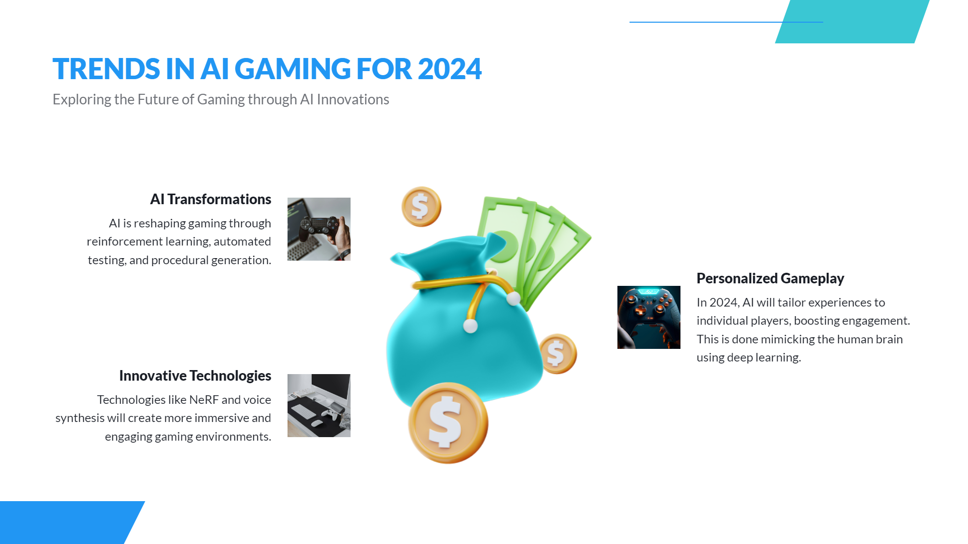
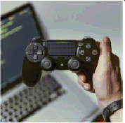


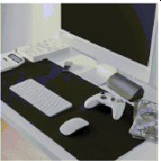

TRENDS IN AI GAMING FOR 2024
Exploring the Future of Gaming through AI Innovations
AI Transformations
AI is reshaping gaming through reinforcement learning, automated testing, and procedural generation.
Personalized Gameplay
In 2024, AI will tailor experiences to individual players, boosting engagement. This is done mimicking the human brain using deep learning.
Innovative Technologies
Technologies like NeRF and voice synthesis will create more immersive and engaging gaming environments.
^œn'ea 1°nç preseutotions

Slide 9
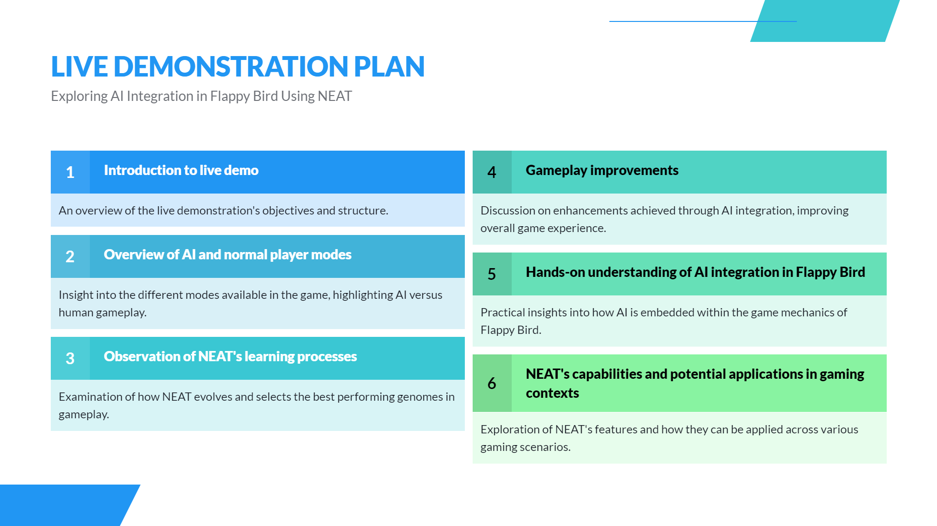


LIVE DEMONSTRATION PLAN
Exploring AI Integration in Flappy Bird Using NEAT
1 Introduction to live demo
An overview of the live demonstration's objectives and structure.
Overview of Al and normal player modes
Insight into the different modes available in the game, highlighting AI versus human gameplay.
Discussion on enhancements achieved through AI integration, improving overall game experience.
Hands-on understanding of AI integration in Flappy Bird
Practical insights into how AI is embedded within the game mechanics of Flappy Bird.
e pabilities and potential applications in gaming
Exploration of NEAT's features and how they can be applied across various gaming scenarios.
s
gameplay.
^œn'ea 1°nç preseutotions

